Slide 1
Weird Science
Cloning and stem cells

Slide 2

Types of cloning
DNA cloning
Reproductive cloning
Therapeutic cloning

Slide 3
Reproductive Cloning
Remove the nucleus from adult egg cell
Transfer DNA from somatic (non gamete) cell into egg
Stimulate division (usually with electricity)
Transfer to uterus and allow to grow

Slide 4
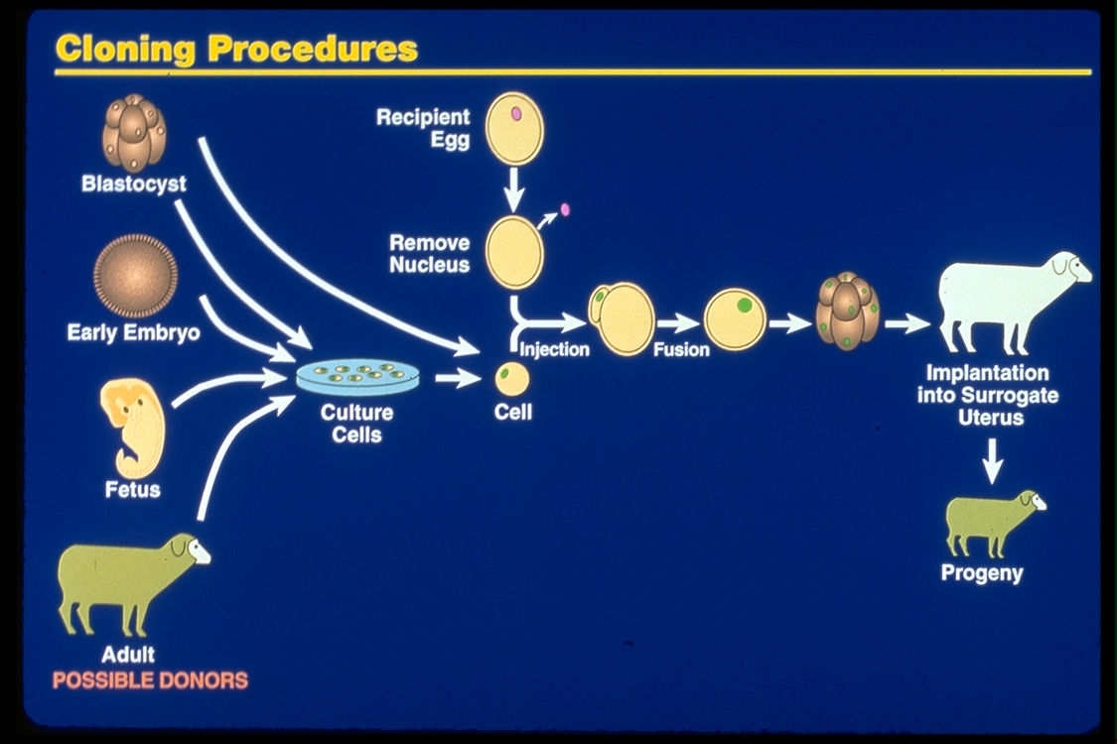
Reproductive Cloning

Slide 5
Problems Associated with Animal Cloning
In most nuclear transplantation studies, only a small percentage of cloned embryos have developed normally to birth, and many cloned animals exhibit defects
Many epigenetic changes, such as acetylation of histones or methylation of DNA, must be reversed in the nucleus from a donor animal in order for genes to be expressed or repressed appropriately for early stages of development
© 2011 Pearson Education, Inc.

Slide 6
Therapeutic cloning
Collect stem cells and allow them to reproduce (usually from embryos after a few days of division)
When these stem cells are injected into areas that need healing, they can grow into new tissue/cells
This technology could be used to grow replacement parts and organs

Slide 7
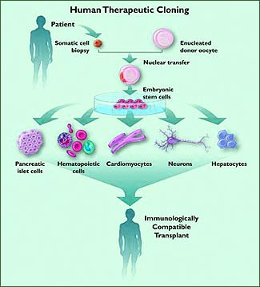
Therapeutic cloning

Slide 8
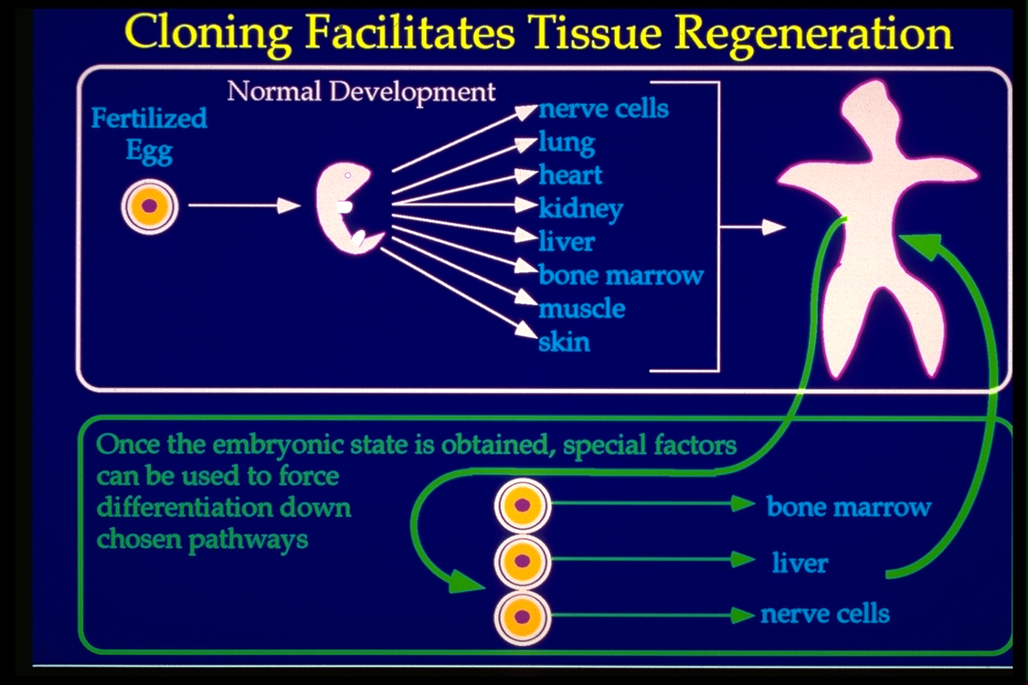
Therapeutic cloning

Slide 9
What are stem cells?
Stem cells are undifferentiated (not-specialized) cells
When appropriate, they can become specialized into many different types of cells (muscle, skin, bone, nervous, etc.)
They can divide without specializing – unique and helpful for lab growth

Slide 10
Types of stem cells
Embryonic – cells from beginning stages of life (scientists only use those created in laboratory conditions) – they can become any kind of cell – they are yet unspecialized
Umbilical cord – contain stem cells in the blood that can become any kind of cell
Adult – found in adults in certain tissues where re-growth may occur – can become limited types of cells

Slide 11
Abilities of stem cells
Totipotent – cells that can become any cell – even a new embryo – from newly fertilized egg
Pluripotent – cells that can become almost any cells (all types except new embryo)
Multipotent – cells that can become many different types of cells – come from adult stem cells

Slide 12
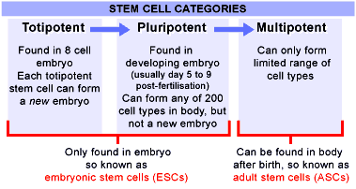
Types of Stem cells

Slide 13
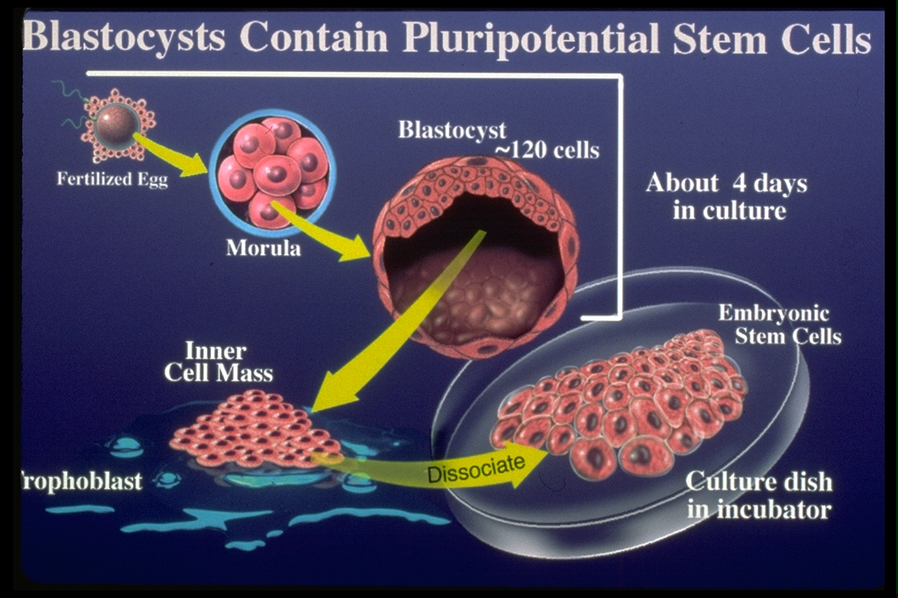
Where do those embryonic stem cells come from?

Slide 14
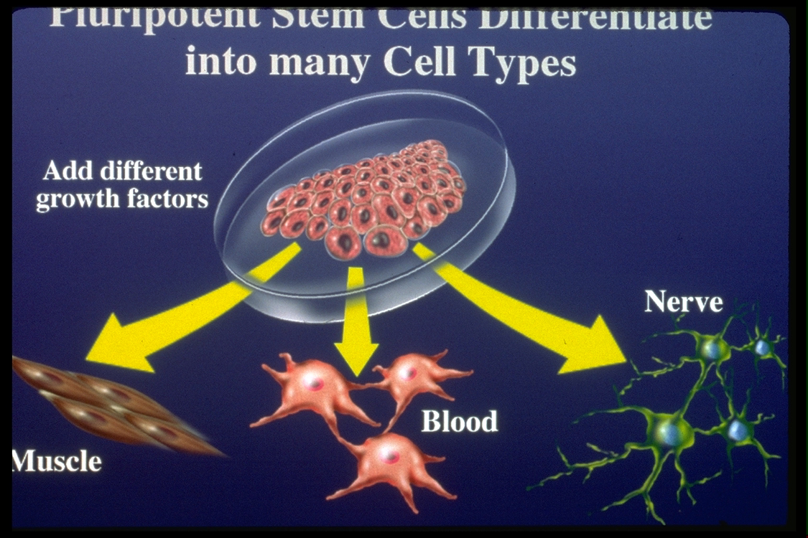
What can those stem cells do?

Slide 15
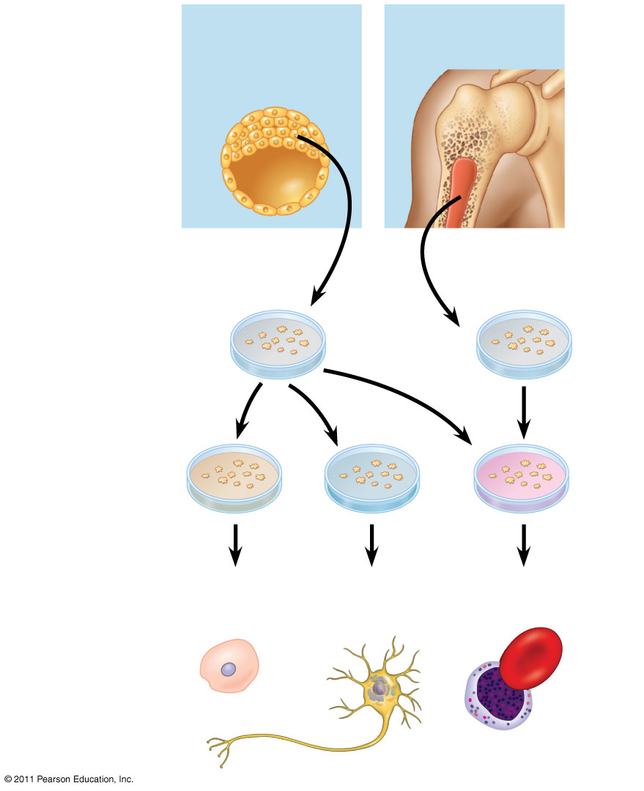
Figure 20.21
Embryonic
stem cells
Adult
stem cells
Cells generating
all embryonic
cell types
Cells generating
some cell types
Cultured
stem cells
Different
culture
conditions
Liver
cells
Nerve
cells
Blood
cells
Different
types of
differentiated
cells
Notes:
Figure 20.21 Working with stem cells.

Slide 16
Induced Pluripotent Stem Cells (iPSC)
In 2007, human somatic cells were transformed into iPSC’s for the first time.
iPSC’s might have huge potential for the future b/c they would be genetically identical to the patient and could be used to cure diseases/solve problems for donor.
Problems that exist now include “turning on” the correct genes to make the cells become what scientists want and preventing them from becoming cancerous.

Slide 17
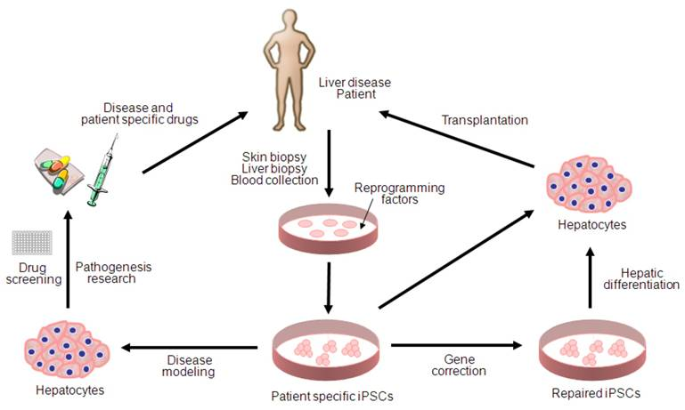

Slide 18
Important to note:
Embryonic stem cells cannot make a new organism unless they are combined with “normal” embryonic cells
Stem cells are not embryos!

Slide 19
How can these different technologies be beneficial to people?
Can make organs that won’t have immune response incompatibilities for transplants
Can treat diseases such as Parkinson's and Alzheimer's diseases, spinal cord injury, strokes, burns, heart disease, diabetes, osteoarthritis and rheumatoid arthritis.

Slide 20
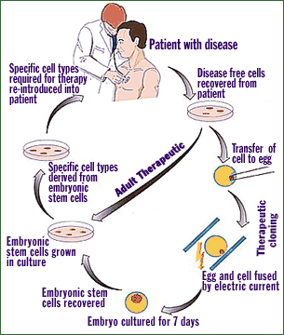
How can this technology be helpful to people?

Slide 21
Science problems that must be overcome:
How to make cells become specialized in the way scientists want them to (make stem cells become brain cells, for instance)
How to make an organ – make cells in laboratory conditions combine and create an organ that could be transplanted into a health patient

